Slide 1

Cloud enabled Altair 8800
Dave Glover
Microsoft Cloud Developer Advocate
@dglover
Search: IoT Tech Community
GitHub: https://github.com/AzureSphereCloudEnabledAltair8800

Slide 2
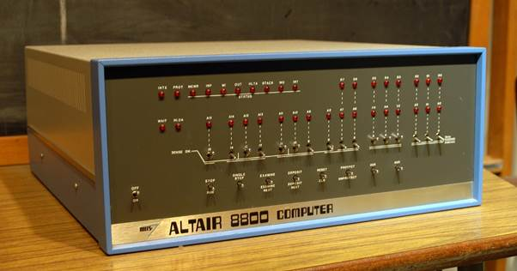

Slide 3
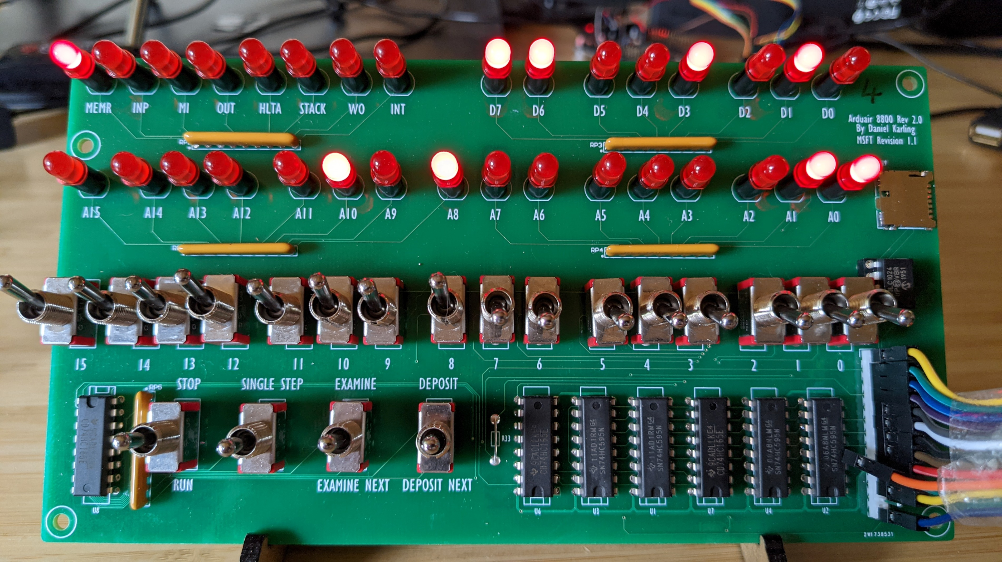

Slide 4
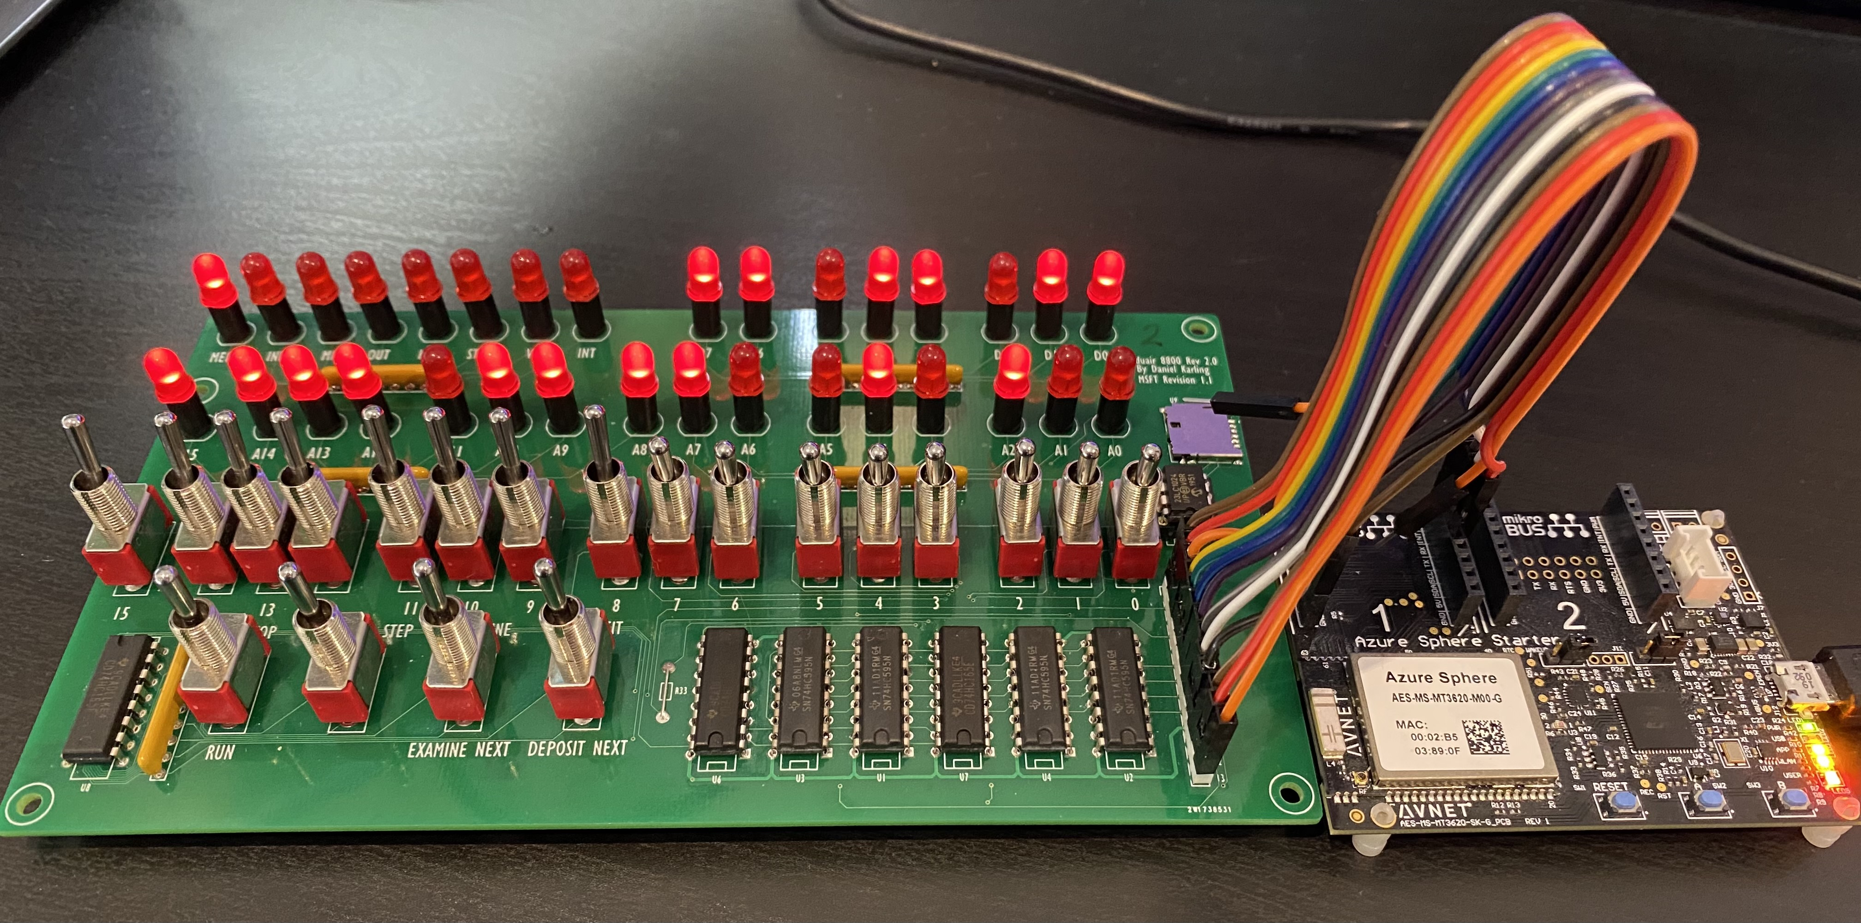

Slide 5
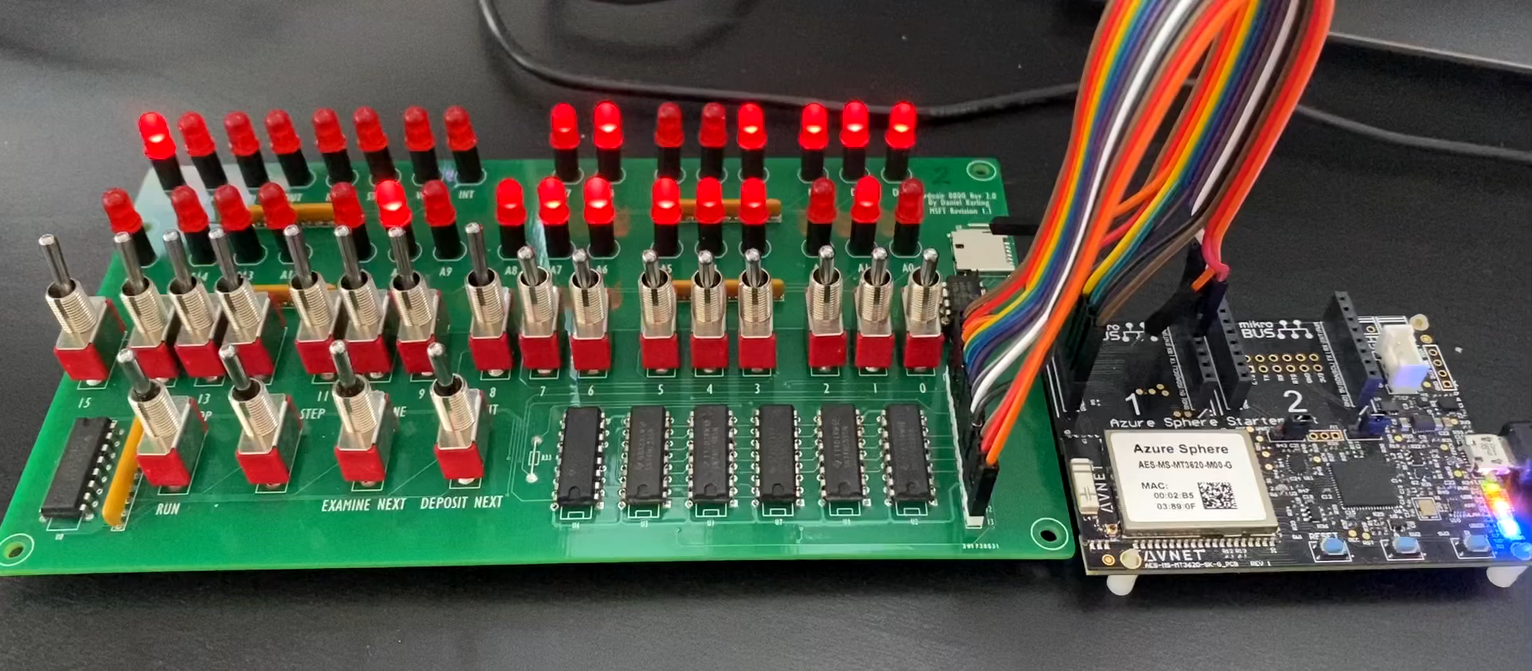

Slide 6
Altair 8800 Emulator on Azure Sphere
Azure Sphere
Azure Cloud Services
Web Terminal
Cortex-A7
Intercore Bridge
Cortex-M4
Azure IoT Central
HTML/CSS/JavaScript
Custom applications
Configuration and Reporting
Virtual disk cache
A>type b:hw.c
Main()
{
unsigned i, j;
printf(“Hello world from the…
for (j = 0; j < 10000; j++) {
for (i = 0; i < 65535; i++) {
BASIC, C, Assembler
Azure Static Web App
Altair BASIC
CP/M 2.2
Altair Web Terminal
Intel 8080 Emulator
Cortex-M4
Azure VM
Terminal IO
Virtual Disk
SD Card
Server
Virtual disk server over MQTT
MQTT & Azure IoT C SDK
Xterm.js
MQTT Broker
(Mosquitto)
Azure Sphere OS
MQTT.js
Internet

Slide 7
Azure Sphere
Cortex-A7
Intercore Bridge
Cortex-M4
Custom applications
Virtual disk cache
BASIC, C, Assembler
Altair BASIC
CP/M 2.2
Intel 8080 Emulator
Cortex-M4
Terminal IO
Virtual Disk
SD Card
Server
MQTT & Azure IoT C SDK
Azure Sphere OS

Slide 8
Altair 8800 Emulator on Azure Sphere
Azure Sphere
Cortex-A7
Intercore Bridge
Cortex-M4
Custom applications
Virtual disk cache
BASIC, C, Assembler
Altair BASIC
CP/M 2.2
Intel 8080 Emulator
Cortex-M4
Terminal IO
Virtual Disk
SD Card
Server
MQTT & Azure IoT C SDK
Azure Sphere OS

Slide 9
Virtual File System Disk Sector Cache and Server
Azure Sphere
Azure Cloud Services
Cortex-A7
Intercore Bridge
Cortex-M4
Azure VM
Custom applications
Virtual disk server over MQTT
Cache-Aside virtual disk 800 sector cache (LRU)
sector
sector
sector
sector
sector
sector
BASIC, C, Assembler
sector
sector
sector
sector
sector
sector
sector
sector
sector
sector
sector
sector
sector
sector
sector
sector
Altair BASIC
CP/M 2.2
sector
sector
sector
sector
sector
sector
sector
sector
sector
sector
sector
sector
sector
sector
sector
sector
sector
sector
sector
sector
sector
sector
Intel 8080 Emulator
sector
sector
sector
sector
sector
sector
sector
sector
sector
sector
sector
sector
sector
sector
sector
sector
Terminal IO
Virtual Disk
sector
sector
sector
sector
sector
sector
sector
sector
sector
sector
sector
sector
sector
sector
sector
sector
MQTT Client
sector
sector
sector
sector
sector
sector
sector
sector
MQTT Broker
(Mosquitto)
Azure Sphere OS
Internet

Slide 10
Altair 8800 Emulator on Azure Sphere
Azure Sphere
Azure Cloud Services
Web Terminal
Cortex-A7
Intercore Bridge
Cortex-M4
Azure Static Web App
HTML/CSS/JavaScript
Custom applications
Virtual disk cache
Altair Web Terminal
A>type b:hw.c
Main()
{
unsigned i, j;
printf(“Hello world from the…
for (j = 0; j < 10000; j++) {
for (i = 0; i < 65535; i++) {
BASIC, C, Assembler
Authentication providers
Azure AD, Google, Facebook, GitHub
Altair BASIC
CP/M 2.2
Intel 8080 Emulator
Cortex-M4
Terminal IO
Virtual Disk
SD Card server
Azure VM
Xterm.js
MQTT Client
MQTT Broker
(Mosquitto)
Azure Sphere OS
MQTT.js
Internet
stdin: Subscribes to altair/<channel_id>/dev
stdout: Publishes on altair/<channel_id>/web
stdin: Subscribes to altair/<channel_id>/web
stdout: Publishes on altair/<channel_id>/dev

Slide 11
Security Patterns with MQTT
DAA and Mosquitto

Slide 12

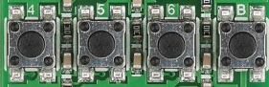

Slide 13
Altair 8800 Emulator on Azure Sphere
Azure Sphere
Cortex A7
Intercore Bridge
Cortex M4
Custom applications
Virtual disk cache
BASIC, C, Assembler
Altair BASIC
CPM 2.2
Intel 8080 Emulator
Cortex M4
Terminal IO
Virtual Disk
SD Card server
MQTT & Azure IoT C SDK
Azure Sphere OS

Slide 14
AI and Cloud Powered Altair on Azure Sphere
Azure Sphere
Web Terminal
Cloud Services
Cortex A7
Altair Emulator
Intercore Bridge
Cortex-M4
HTML/CSS/JavaScript
Azure IoT Central
Configuration and Reporting
Custom applications
A>type b:hw.c
Main()
{
unsigned i, j;
printf(“Hello world from the…
for (j = 0; j < 10000; j++) {
for (i = 0; i < 65535; i++) {
Real-time Storage services
Altair BASIC
BASIC, C, Assembler
CP/M 2.2
Open Weather Map
CPU Monitor
Weather and Pollution data
Intel 8080 Emulator
Cortex-M4
Terminal IO & Cloud Services
Web Terminal
Xterm.js
AzureSphereDevX Middleware
Real-time
TinyML Movement classification
Azure Anomaly Detection
Event Loop Library
Communications
Web Sockets
Climate anomaly detection
WebSocket & Azure IoT C
Network

Slide 15
AI and Cloud Powered Altair 8800 Everywhere
POSIX Compatible Operating Systems
Windows WSL, Linux, macOS, Raspberry Pi
Web Terminal
Cloud Services
Altair Emulator
HTML/CSS/JavaScript
Azure IoT Central
Custom applications
A>type b:hw.c
Main()
{
unsigned i, j;
printf(“Hello world from the…
for (j = 0; j < 10000; j++) {
for (i = 0; i < 65535; i++) {
Configuration and Reporting
Altair BASIC
BASIC, C, Assembler
CP/M 2.2
CPU Monitor
Open Weather Map
Weather and Pollution data
Intel 8080 Emulator
Web Terminal
Xterm.js
Terminal IO & Cloud Services
EdgeDevX Middleware
Anomaly Detection
Libuv Event Loop Library
Communications
Web Sockets
Climate anomaly detection
WebSocket & Azure IoT C

Slide 16
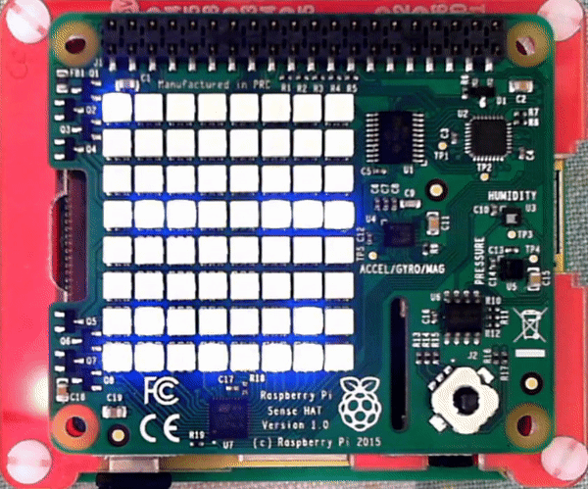

Slide 17
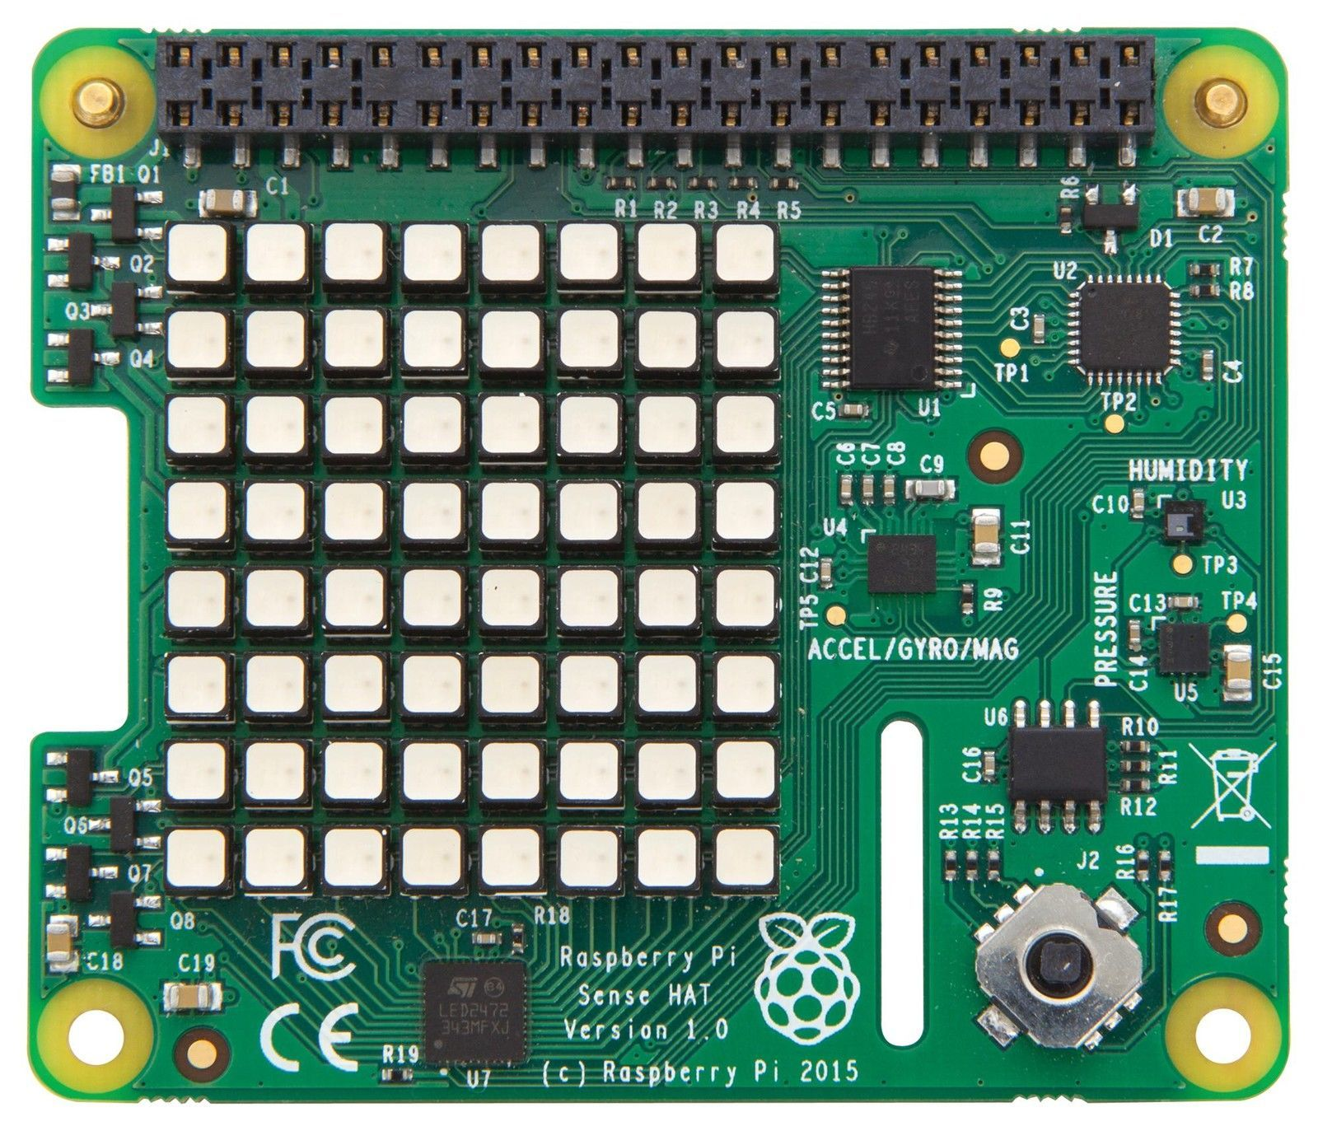
MEMR
STACK
INP
OUT
HLTA
WO
INT
MI
Data Bus
7
6
5
4
3
2
1
0
15
14
13
12
11
10
9
8
Address Bus
7
6
5
4
3
2
1
0

